Slide 1
On Explaining Quantitative Bipolar Argumentation Frameworks (QBAFs)
Dr Xiang Yin
Research Associate, Department of Computing
Imperial College London, UK
23/10/2025

Slide 2
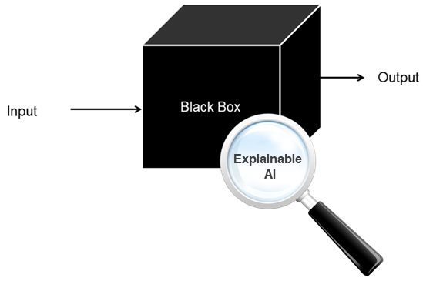
Background
What is Explainable AI (XAI)?
Crucial in high-stakes decisions.
Image Source: https://worldline.com/en/home/main-navigation/resources/blogs/2021/ever-heard-of-the-ai-black-box-problem
Notes:
The motivation why I did this work.
Before talking about why I choose QBAFs, let us first look at an example of the QBAF.

Slide 3
Background
Argumentation Frameworks (AFs) can model and reason among conflicting information.
Quantitative Bipolar AFs (QBAFs).
Notes:
Argumentation Frameworks (AFs) can model and reason among conflicting information, which is useful in real-world applications.
In today’s talk, I focus on Quantitative Bipolar AFs (QBAFs).

Slide 4
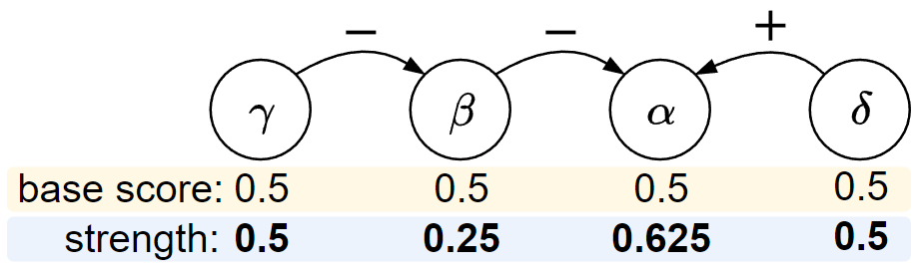
Quantitative Bipolar Argumentation Frameworks (QBAFs)
α: We should go play football this afternoon.​
β: We'd better not because it may rain this afternoon.
γ: The weather forecast says there is no rain today.
δ: Playing football will be fun and refreshing.
Notes:
(1) First, as a brief introduction, (2) I will show an example of the argumentation framework (AF), (3) which is composed of arguments and relations.
In this graph, nodes are arguments and edges show the relationship between them.
+ (plus) means one argument supports another while
– (minus) means one argument attacks another.
Then let’s take a look at the contents of the arguments.
Alpha says …
Beta says … so beta attacks alpha.
Gamma says … so gamma supports alpha.
Delta says … so supports alpha.
In Quantitative AF, each argument is assigned with a base score as the initial strength, and we use the gradual semantics to evaluate the QBAF.
Simply speaking, we can see gradual semantics as a function, which takes the base scores as the input and compute the final strengths as the output.
We use tau to denote the base scores and sigma to denote the final strengths of the arguments.
As the computing process as it is not important here, so I will skip it.

Slide 5
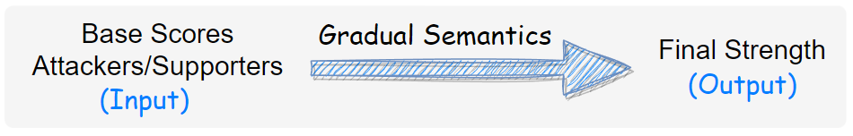
Quantitative Bipolar Argumentation Frameworks (QBAFs)
Gradual Semantics: Evaluating the final strengths of arguments.
Notes:
(1) First, as a brief introduction, (2) I will show an example of the argumentation framework (AF), (3) which is composed of arguments and relations.
In this graph, nodes are arguments and edges show the relationship between them.
+ (plus) means one argument supports another while
– (minus) means one argument attacks another.
Then let’s take a look at the contents of the arguments.
Alpha says …
Beta says … so beta attacks alpha.
Gamma says … so gamma supports alpha.
Delta says … so supports alpha.
In Quantitative AF, each argument is assigned with a base score as the initial strength, and we use the gradual semantics to evaluate the QBAF.
Simply speaking, we can see gradual semantics as a function, which takes the base scores as the input and compute the final strengths as the output.
We use tau to denote the base scores and sigma to denote the final strengths of the arguments.
As the computing process as it is not important here, so I will skip it.

Slide 6
Quantitative Bipolar Argumentation Frameworks (QBAFs)
QBAFs provide transparent reasoning process.
Notes:
(1) First, as a brief introduction, (2) I will show an example of the argumentation framework (AF), (3) which is composed of arguments and relations.
In this graph, nodes are arguments and edges show the relationship between them.
+ (plus) means one argument supports another while
– (minus) means one argument attacks another.
Then let’s take a look at the contents of the arguments.
Alpha says …
Beta says … so beta attacks alpha.
Gamma says … so gamma supports alpha.
Delta says … so supports alpha.
In Quantitative AF, each argument is assigned with a base score as the initial strength, and we use the gradual semantics to evaluate the QBAF.
Simply speaking, we can see gradual semantics as a function, which takes the base scores as the input and compute the final strengths as the output.
We use tau to denote the base scores and sigma to denote the final strengths of the arguments.
As the computing process as it is not important here, so I will skip it.

Slide 7
Dialogical Explanations
User: Why should we play football this afternoon?
QBAF: We should play football because it will be fun and refreshing.
User: What if it rains this afternoon?
QBAF: The weather forecast says there is no rain today.
Notes:
(1) First, as a brief introduction, (2) I will show an example of the argumentation framework (AF), (3) which is composed of arguments and relations.
In this graph, nodes are arguments and edges show the relationship between them.
+ (plus) means one argument supports another while
– (minus) means one argument attacks another.
Then let’s take a look at the contents of the arguments.
Alpha says …
Beta says … so beta attacks alpha.
Gamma says … so gamma supports alpha.
Delta says … so supports alpha.
In Quantitative AF, each argument is assigned with a base score as the initial strength, and we use the gradual semantics to evaluate the QBAF.
Simply speaking, we can see gradual semantics as a function, which takes the base scores as the input and compute the final strengths as the output.
We use tau to denote the base scores and sigma to denote the final strengths of the arguments.
As the computing process as it is not important here, so I will skip it.

Slide 8
Research Gap
QBAFs can provide qualitative explanations,
but fail to provide quantitative explanations.
Notes:
QBAFs can provide qualitative explanations through their transparent structures, but they fail to provide quantitative explanations.

Slide 9
Research Question
Given an argument to be explained (topic argument) in a QBAF,
how can we explain its strength under gradual semantics?
Notes:
Now, I will show an example of applying Relation Attributions explanations to the previous QBAF.
Suppose that we want to explain the argument alpha.
To be clear, we labelled the edges with r1-r5.
Then we applied our method and got the results here:
We see that we have three blue edges, which means that they have positive influence, and we have two red edges which means that have negative influence on the alpha.
Among positive contributions, r1 and r2 are the main contributors, this is because gamma directly supports alpha through r1 and delta directly supports alpha through r2.
As for r3, since gamma supports delta, and delta supports alpha, so gamma indirectly supports alpha through r3 and r2, so r3 has a positive influence on alpha,
but r3 is not directly connected to alpha, so the magnitude is less than that of r1 and r2.
Among negative contributors, r5 is the main contributor as beta directly attacks alpha through r5;
R4 is a minor negative contributor because beta attacks delta, and delta is a supporter of alpha, so beta indirectly attacks alpha through r4 and r2.
Here, what is worth mentioning is that if we sum up all the relation attributions, then the sum exactly equals to the difference between the base score and final strength of alpha,
which explains how the base score changes to the final strength under the evaluation of gradual semantics.

Slide 10
Main Objectives
O1: To investigate the influence of arguments in explaining the outcome.
O2: To investigate the influence of relations in explaining the outcome.
O3: To investigate the influence of base scores in explaining the outcome.
Notes:
…
To achieve the research objectives, I made three main contributions.

Slide 11
Main Theories
Argument Attribution Explanations (AAEs).
Relation Attribution Explanations (RAEs).
Counterfactual Explanations (CEs).
Notes:
Now, I will show an example of applying Relation Attributions explanations to the previous QBAF.
Suppose that we want to explain the argument alpha.
To be clear, we labelled the edges with r1-r5.
Then we applied our method and got the results here:
We see that we have three blue edges, which means that they have positive influence, and we have two red edges which means that have negative influence on the alpha.
Among positive contributions, r1 and r2 are the main contributors, this is because gamma directly supports alpha through r1 and delta directly supports alpha through r2.
As for r3, since gamma supports delta, and delta supports alpha, so gamma indirectly supports alpha through r3 and r2, so r3 has a positive influence on alpha,
but r3 is not directly connected to alpha, so the magnitude is less than that of r1 and r2.
Among negative contributors, r5 is the main contributor as beta directly attacks alpha through r5;
R4 is a minor negative contributor because beta attacks delta, and delta is a supporter of alpha, so beta indirectly attacks alpha through r4 and r2.
Here, what is worth mentioning is that if we sum up all the relation attributions, then the sum exactly equals to the difference between the base score and final strength of alpha,
which explains how the base score changes to the final strength under the evaluation of gradual semantics.

Slide 12
Argument Attribution Explanations (AAEs)
Argument Attribution Explanations in Quantitative Bipolar Argumentation Frameworks. X. Yin, N. Potyka, F. Toni. ECAI, 2023.
Notes:
1+2+2+1
(1)To solve this problem, we gained the idea from the attribution explanations in ML.
(2)In ML, people use feature attributions to explain the output of machine learning models.
They assign the importance scores to features to show their contributions, to see if the feature contributes positively or negatively to the output, and how much the feature contributes to the output.
(2)Here, we were wondering if it possible to transfer this idea from ML to the argumentation setting.
That is, instead of attributing the importance scores to the features, we attribute them to the arguments
and see if the argument attributions can explain the output of the QBAFs, that is the strengths of the arguments.
(1)Luckily, the answer is yes.

Slide 13


Motivation for AAEs
Machine Learning
Argument Attribution Explanations in Quantitative Bipolar Argumentation Frameworks. X. Yin, N. Potyka, F. Toni. ECAI, 2023.
Notes:
1+2+2+1
(1)To solve this problem, we gained the idea from the attribution explanations in ML.
(2)In ML, people use feature attributions to explain the output of machine learning models.
They assign the importance scores to features to show their contributions, to see if the feature contributes positively or negatively to the output, and how much the feature contributes to the output.
(2)Here, we were wondering if it possible to transfer this idea from ML to the argumentation setting.
That is, instead of attributing the importance scores to the features, we attribute them to the arguments
and see if the argument attributions can explain the output of the QBAFs, that is the strengths of the arguments.
(1)Luckily, the answer is yes.

Slide 14
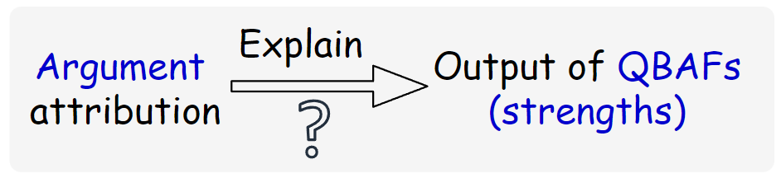
Motivation for AAEs
Machine Learning
Argumentation
Argument Attribution Explanations in Quantitative Bipolar Argumentation Frameworks. X. Yin, N. Potyka, F. Toni. ECAI, 2023.

Slide 15
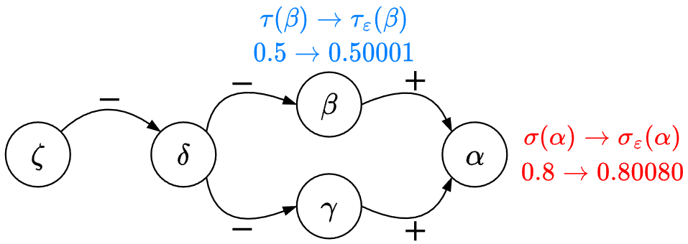
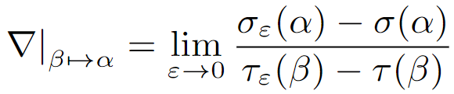
Argument Attribution Explanations (AAEs)
Gradient-based attribution method
Intuition: Capture the sensitivity of an argument wrt. another.
Example
Base score
Final strength
Definition
Argument Attribution Explanations in Quantitative Bipolar Argumentation Frameworks. X. Yin, N. Potyka, F. Toni. ECAI, 2023.
Notes:
So we propose AAEs.
To measure the contribution from one argument to another, we use gradient-based attribution method.
The intuition is to …
For example, if we want to know the contribution from beta to alpha, then we … [mention what is tau and sigma]

Slide 16
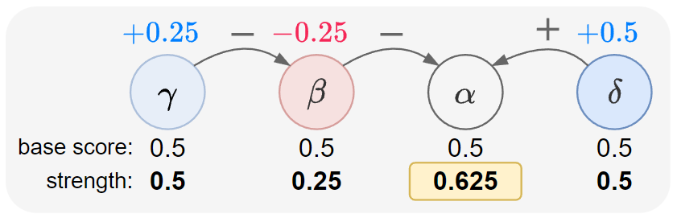
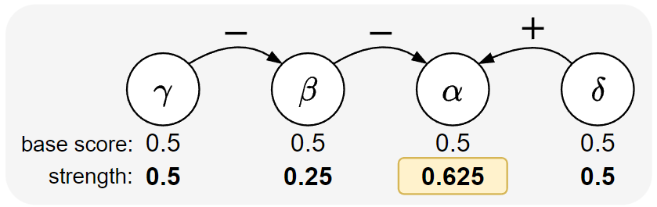
Argument Attribution Explanations
Argument Attribution Explanations in Quantitative Bipolar Argumentation Frameworks. X. Yin, N. Potyka, F. Toni. ECAI, 2023.
Notes:
Now, I will show an example of applying Relation Attributions explanations to the previous QBAF.
Suppose that we want to explain the argument alpha.
To be clear, we labelled the edges with r1-r5.
Then we applied our method and got the results here:
We see that we have three blue edges, which means that they have positive influence, and we have two red edges which means that have negative influence on the alpha.
Among positive contributions, r1 and r2 are the main contributors, this is because gamma directly supports alpha through r1 and delta directly supports alpha through r2.
As for r3, since gamma supports delta, and delta supports alpha, so gamma indirectly supports alpha through r3 and r2, so r3 has a positive influence on alpha,
but r3 is not directly connected to alpha, so the magnitude is less than that of r1 and r2.
Among negative contributors, r5 is the main contributor as beta directly attacks alpha through r5;
R4 is a minor negative contributor because beta attacks delta, and delta is a supporter of alpha, so beta indirectly attacks alpha through r4 and r2.
Here, what is worth mentioning is that if we sum up all the relation attributions, then the sum exactly equals to the difference between the base score and final strength of alpha,
which explains how the base score changes to the final strength under the evaluation of gradual semantics.

Slide 17
Argument Attribution Explanations
Argument Attribution Explanations in Quantitative Bipolar Argumentation Frameworks. X. Yin, N. Potyka, F. Toni. ECAI, 2023.
Notes:
Now, I will show an example of applying Relation Attributions explanations to the previous QBAF.
Suppose that we want to explain the argument alpha.
To be clear, we labelled the edges with r1-r5.
Then we applied our method and got the results here:
We see that we have three blue edges, which means that they have positive influence, and we have two red edges which means that have negative influence on the alpha.
Among positive contributions, r1 and r2 are the main contributors, this is because gamma directly supports alpha through r1 and delta directly supports alpha through r2.
As for r3, since gamma supports delta, and delta supports alpha, so gamma indirectly supports alpha through r3 and r2, so r3 has a positive influence on alpha,
but r3 is not directly connected to alpha, so the magnitude is less than that of r1 and r2.
Among negative contributors, r5 is the main contributor as beta directly attacks alpha through r5;
R4 is a minor negative contributor because beta attacks delta, and delta is a supporter of alpha, so beta indirectly attacks alpha through r4 and r2.
Here, what is worth mentioning is that if we sum up all the relation attributions, then the sum exactly equals to the difference between the base score and final strength of alpha,
which explains how the base score changes to the final strength under the evaluation of gradual semantics.

Slide 18
Relation Attribution Explanations (RAEs)
Explaining Arguments’ Strength: Unveiling the Role of Attacks and Supports. X. Yin, N. Potyka, F. Toni. IJCAI, 2024.
Notes:
1+2+2+1
(1)To solve this problem, we gained the idea from the attribution explanations in ML.
(2)In ML, people use feature attributions to explain the output of machine learning models.
They assign the importance scores to features to show their contributions, to see if the feature contributes positively or negatively to the output, and how much the feature contributes to the output.
(2)Here, we were wondering if it possible to transfer this idea from ML to the argumentation setting.
That is, instead of attributing the importance scores to the features, we attribute them to the arguments
and see if the argument attributions can explain the output of the QBAFs, that is the strengths of the arguments.
(1)Luckily, the answer is yes.

Slide 19
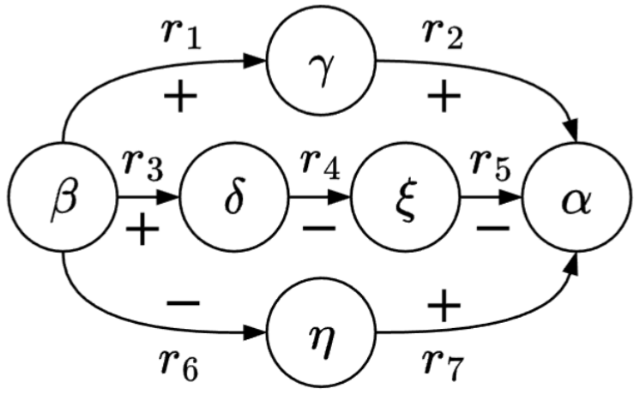
Motivation for RAEs
Similar idea to AAEs
Fine-grained explanations than AAEs
Explaining Arguments’ Strength: Unveiling the Role of Attacks and Supports. X. Yin, N. Potyka, F. Toni. IJCAI, 2024.
Notes:
Now, I will show an example of applying Relation Attributions explanations to the previous QBAF.
Suppose that we want to explain the argument alpha.
To be clear, we labelled the edges with r1-r5.
Then we applied our method and got the results here:
We see that we have three blue edges, which means that they have positive influence, and we have two red edges which means that have negative influence on the alpha.
Among positive contributions, r1 and r2 are the main contributors, this is because gamma directly supports alpha through r1 and delta directly supports alpha through r2.
As for r3, since gamma supports delta, and delta supports alpha, so gamma indirectly supports alpha through r3 and r2, so r3 has a positive influence on alpha,
but r3 is not directly connected to alpha, so the magnitude is less than that of r1 and r2.
Among negative contributors, r5 is the main contributor as beta directly attacks alpha through r5;
R4 is a minor negative contributor because beta attacks delta, and delta is a supporter of alpha, so beta indirectly attacks alpha through r4 and r2.
Here, what is worth mentioning is that if we sum up all the relation attributions, then the sum exactly equals to the difference between the base score and final strength of alpha,
which explains how the base score changes to the final strength under the evaluation of gradual semantics.

Slide 20
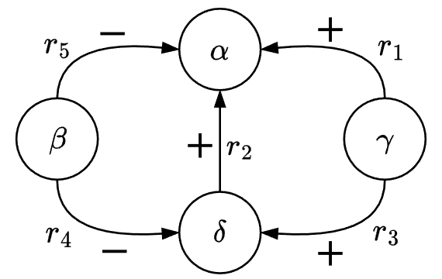
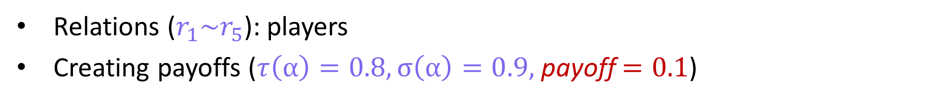
Relation Attribution Explanations (RAEs)
Shapley values
A popular contribution measurement in game theory.
Computing the weighted marginal contributions.
Example
Relations ($r_{1}\sim r_{5}$): players
Creating payoffs ($τ\left(α\right)=0.8, σ\left(α\right)=0.9,$payoff $=0.1$)
Explaining Arguments’ Strength: Unveiling the Role of Attacks and Supports. X. Yin, N. Potyka, F. Toni. IJCAI, 2024.
Notes:
In order to measure the contribution value of each relation, we use Shapley values.
Shapley-based attribution method is a very popular contribution measurement initially proposed in game theory.
Basically, Shapley-based method computes the weighted marginal contributions as the attribution scores.
To be easier, let us see an example here.
[P] Suppose we want to explain the strength of \alpha.
[P] In Shapley values, all the relations are seen as the players in a game, and they play together to create the payoff.
From the argumentative view to understand Shapley values, it is like this:
Suppose the initial strength of \alpha is 0.8, and after reasoning, it has a final strength of 0.9, then we say the payoff in this game is 0.1, and this total payoff is created by 5 players r_1 to r_5.

Slide 21
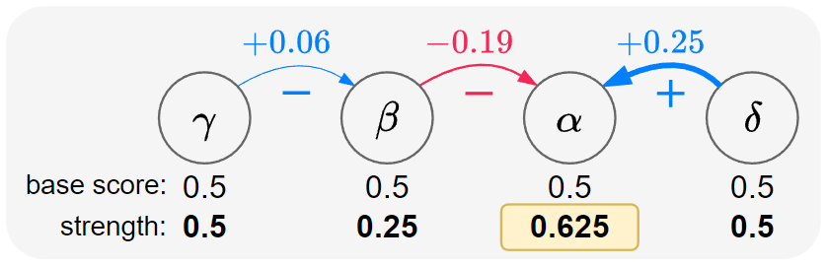
Relation Attribution Explanations
Explaining Arguments’ Strength: Unveiling the Role of Attacks and Supports. X. Yin, N. Potyka, F. Toni. IJCAI, 2024.
Notes:
Now, I will show an example of applying Relation Attributions explanations to the previous QBAF.
Suppose that we want to explain the argument alpha.
To be clear, we labelled the edges with r1-r5.
Then we applied our method and got the results here:
We see that we have three blue edges, which means that they have positive influence, and we have two red edges which means that have negative influence on the alpha.
Among positive contributions, r1 and r2 are the main contributors, this is because gamma directly supports alpha through r1 and delta directly supports alpha through r2.
As for r3, since gamma supports delta, and delta supports alpha, so gamma indirectly supports alpha through r3 and r2, so r3 has a positive influence on alpha,
but r3 is not directly connected to alpha, so the magnitude is less than that of r1 and r2.
Among negative contributors, r5 is the main contributor as beta directly attacks alpha through r5;
R4 is a minor negative contributor because beta attacks delta, and delta is a supporter of alpha, so beta indirectly attacks alpha through r4 and r2.
Here, what is worth mentioning is that if we sum up all the relation attributions, then the sum exactly equals to the difference between the base score and final strength of alpha,
which explains how the base score changes to the final strength under the evaluation of gradual semantics.

Slide 22
Relation Attribution Explanations
Explaining Arguments’ Strength: Unveiling the Role of Attacks and Supports. X. Yin, N. Potyka, F. Toni. IJCAI, 2024.
Notes:
Now, I will show an example of applying Relation Attributions explanations to the previous QBAF.
Suppose that we want to explain the argument alpha.
To be clear, we labelled the edges with r1-r5.
Then we applied our method and got the results here:
We see that we have three blue edges, which means that they have positive influence, and we have two red edges which means that have negative influence on the alpha.
Among positive contributions, r1 and r2 are the main contributors, this is because gamma directly supports alpha through r1 and delta directly supports alpha through r2.
As for r3, since gamma supports delta, and delta supports alpha, so gamma indirectly supports alpha through r3 and r2, so r3 has a positive influence on alpha,
but r3 is not directly connected to alpha, so the magnitude is less than that of r1 and r2.
Among negative contributors, r5 is the main contributor as beta directly attacks alpha through r5;
R4 is a minor negative contributor because beta attacks delta, and delta is a supporter of alpha, so beta indirectly attacks alpha through r4 and r2.
Here, what is worth mentioning is that if we sum up all the relation attributions, then the sum exactly equals to the difference between the base score and final strength of alpha,
which explains how the base score changes to the final strength under the evaluation of gradual semantics.

Slide 23
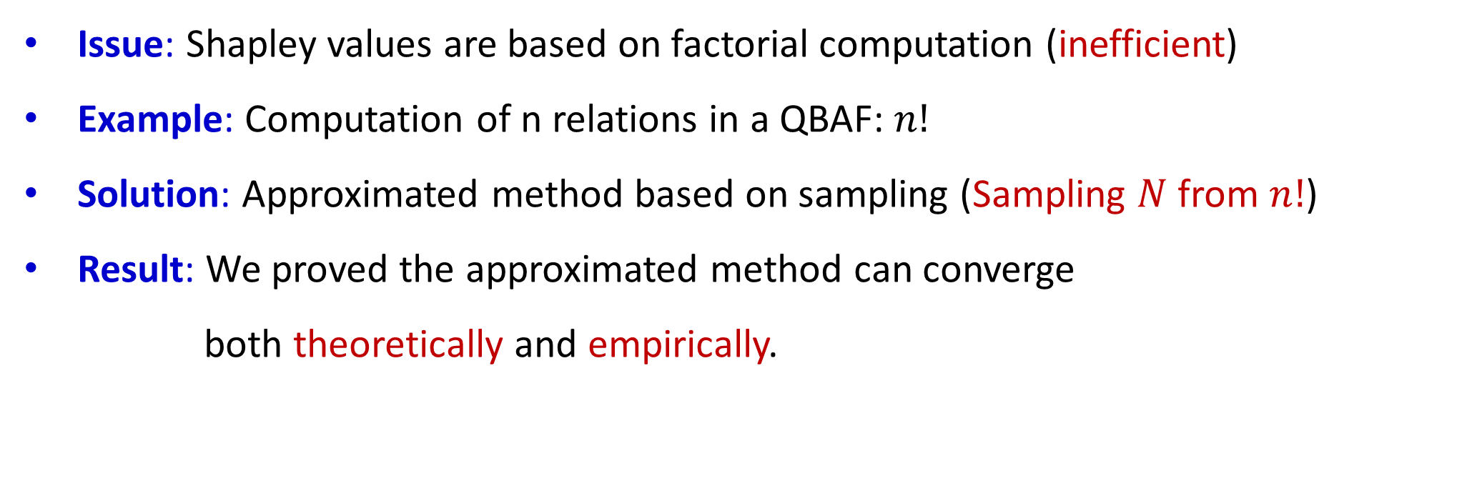
Approximating RAEs Probabilistically
Issue: Shapley values are based on factorial computation (inefficient)
Example: Computation of n relations in a QBAF: $n!$
Solution: Approximated method based on sampling (Sampling $N$ from $n!$)
Result: We proved the approximated method can converge
both theoretically and empirically.
Explaining Arguments’ Strength: Unveiling the Role of Attacks and Supports. X. Yin, N. Potyka, F. Toni. IJCAI, 2024.
Notes:
However, here is an issue for the Shapley based attribution explanations.

Slide 24
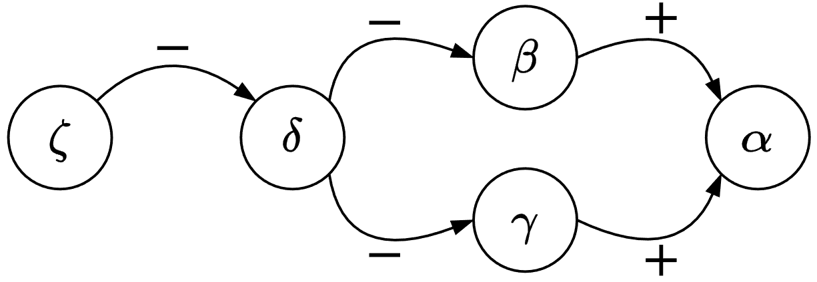
Properties of AAEs/RAEs
Intuition: Evaluate AAEs/RAEs theoretically to make sure they behave well.
Two Examples:
1. A supporter’s AAE should be ≥ 0 (from β to α).
2. Arguments/relations without influences should have an AAE/RAE of 0 (from α to β).
Explaining Arguments’ Strength: Unveiling the Role of Attacks and Supports. X. Yin, N. Potyka, F. Toni. IJCAI, 2024.
Notes:
Now let us see some proberties.
The intuition is to …
Two examples…

Slide 25
Counterfactual Explanations (CEs)
CE-QArg: Counterfactual Explanations for Quantitative Bipolar Argumentation Frameworks. X. Yin, N. Potyka, F. Toni. KR, 2024.
Notes:
1+2+2+1
(1)To solve this problem, we gained the idea from the attribution explanations in ML.
(2)In ML, people use feature attributions to explain the output of machine learning models.
They assign the importance scores to features to show their contributions, to see if the feature contributes positively or negatively to the output, and how much the feature contributes to the output.
(2)Here, we were wondering if it possible to transfer this idea from ML to the argumentation setting.
That is, instead of attributing the importance scores to the features, we attribute them to the arguments
and see if the argument attributions can explain the output of the QBAFs, that is the strengths of the arguments.
(1)Luckily, the answer is yes.

Slide 26
Motivation for CEs
AAEs and RAEs explain the current strength of α (topic argument), but fail to provide explanations on obtaining a counterfactual strength of α.
CE-QArg: Counterfactual Explanations for Quantitative Bipolar Argumentation Frameworks. X. Yin, N. Potyka, F. Toni. KR, 2024.
Notes:
Now, I will show an example of applying Relation Attributions explanations to the previous QBAF.
Suppose that we want to explain the argument alpha.
To be clear, we labelled the edges with r1-r5.
Then we applied our method and got the results here:
We see that we have three blue edges, which means that they have positive influence, and we have two red edges which means that have negative influence on the alpha.
Among positive contributions, r1 and r2 are the main contributors, this is because gamma directly supports alpha through r1 and delta directly supports alpha through r2.
As for r3, since gamma supports delta, and delta supports alpha, so gamma indirectly supports alpha through r3 and r2, so r3 has a positive influence on alpha,
but r3 is not directly connected to alpha, so the magnitude is less than that of r1 and r2.
Among negative contributors, r5 is the main contributor as beta directly attacks alpha through r5;
R4 is a minor negative contributor because beta attacks delta, and delta is a supporter of alpha, so beta indirectly attacks alpha through r4 and r2.
Here, what is worth mentioning is that if we sum up all the relation attributions, then the sum exactly equals to the difference between the base score and final strength of alpha,
which explains how the base score changes to the final strength under the evaluation of gradual semantics.

Slide 27
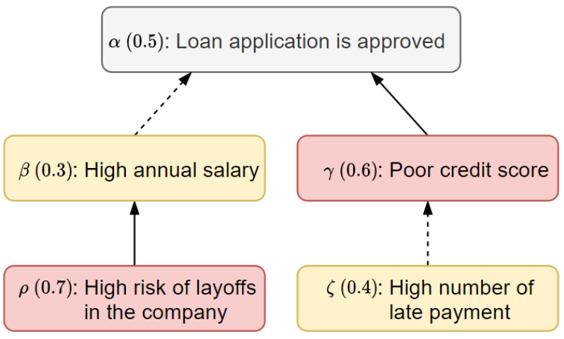
Example
CE-QArg: Counterfactual Explanations for Quantitative Bipolar Argumentation Frameworks. X. Yin, N. Potyka, F. Toni. KR, 2024.
Notes:
【mention】
[P]
(1) First, as a brief introduction, (2) I will show an example of the Quantitative Bipolar Argumentation Framework in the loan application setting.
[P]
In this graph, nodes are arguments and edges show the relationship between them.
Solid edges mean one argument attacks another while
Dashed edges mean one argument supports another.
We use red nodes to denote attackers, and yellow nodes are supporters.
The content of arguments are shown here, we see that alpha, beta, rho, gamma, zeta.
[P]
In the QBAFs, each argument is assigned with a base score as the initial strength, as we can see in this figure====➔ and we use the gradual semantics to evaluate the final strength in QBAFs.

Slide 28
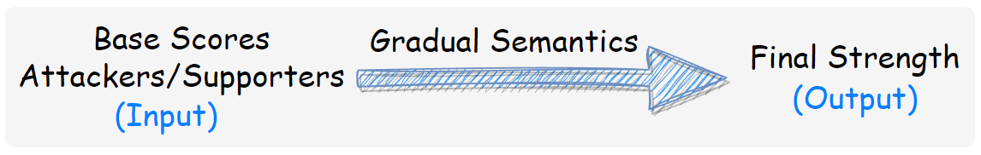
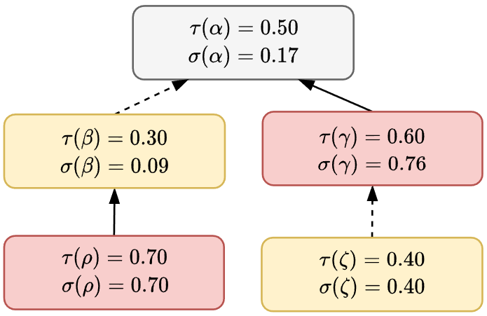
Example
CE-QArg: Counterfactual Explanations for Quantitative Bipolar Argumentation Frameworks. X. Yin, N. Potyka, F. Toni. KR, 2024.
Notes:
【use word, unfortunately】
and we use the gradual semantics to evaluate the QBAF.
[P]
Simply speaking, we can see gradual semantics as a function, which takes the base scores as the input and compute the final strengths as the output.
[P]
Here, We use \tau to denote the base scores and sigma to denote the final strengths of the arguments.
As the computing process of the semantics is not important here, so I will skip it and just show the result here. We see the final strength of alpha is 0.17
In this example, assume the loan application will be accepted if and only if the final strength of alpha is greater than 0.5.
And now the applicant is thinking, how can I make the final strength greater than 0.5?
Maybe I try to increase my salary then the base score for beta increases, which would be helpful
Or, I can decrease the base score of gamma by improving current poor credit score.

Slide 29
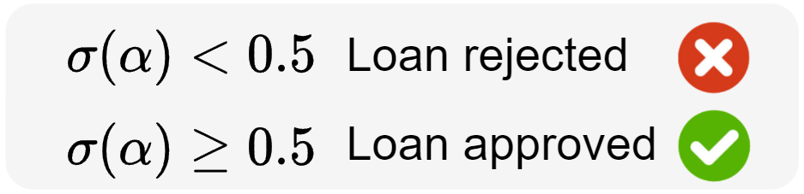
Example
CE-QArg: Counterfactual Explanations for Quantitative Bipolar Argumentation Frameworks. X. Yin, N. Potyka, F. Toni. KR, 2024.
Notes:
【use word, unfortunately】
【evaluate动词用ing形式？后续也是要注意】
and we use the gradual semantics to evaluate the QBAF.
[P]
Simply speaking, we can see gradual semantics as a function, which takes the base scores as the input and compute the final strengths as the output.
[P]
Here, We use \tau to denote the base scores and sigma to denote the final strengths of the arguments.
As the computing process of the semantics is not important here, so I will skip it and just show the result here. We see the final strength of alpha is 0.17
In this example, assume the loan application will be accepted if and only if the final strength of alpha is greater than 0.5.
And now the applicant is thinking, how can I make the final strength greater than 0.5?
Maybe I try to increase my salary then the base score for beta increases, which would be helpful
Or, I can decrease the base score of gamma by improving current poor credit score.

Slide 30
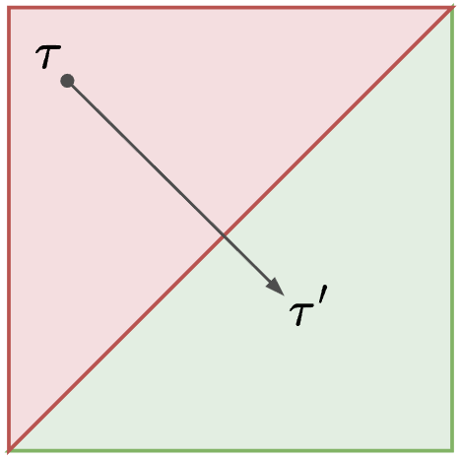


Research Question
How can we obtain a desired final strength of α (topic argument) by adjusting the base scores of the other arguments?
$σ\left(α\right)<0.5$
$σ\left(α\right)≥0.5$
CE-QArg: Counterfactual Explanations for Quantitative Bipolar Argumentation Frameworks. X. Yin, N. Potyka, F. Toni. KR, 2024.
Notes:
[P] Now, we come to the research question, that xxx.
For better understanding, I will show a figure here.
\tau is xxx
In this figure, the red area (top left corner) means rejection area the final strength of the topic argument is less than 0.5, which is rejected, and the green area (bottom right corner) means acceptance area, the strength is greater than 0.5.
On the boundary, the strength is exactly 0.5
As we can see, if the applicant wants to get the loan, then the goal is moving to the green area, or at least on the boundary.
For example, t1’ t2’ t3’ are all possible solutions. (we call them counterfactual explanations, because they can lead to a different result.)

Slide 31
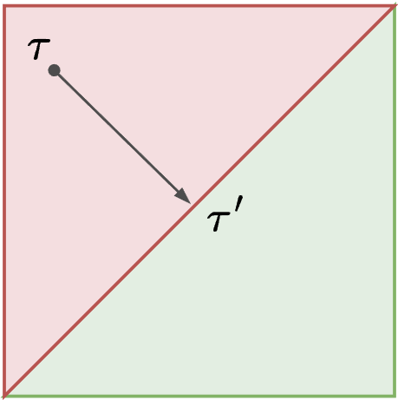
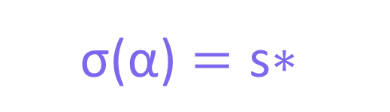
Counterfactual Problems for QBAFs
Strong
$$\text{σ}\text{(}\text{α}\text{)}=\text{s}\text{∗}$$
CE-QArg: Counterfactual Explanations for Quantitative Bipolar Argumentation Frameworks. X. Yin, N. Potyka, F. Toni. KR, 2024.
Notes:
Next, we define three counterfactual problems. Depending on the position of \tau.
(They are strong /approximate /weak CF problems.)
(I will show a figure to distinguish these three problem.)
Strong: exactly hit the desired strength s*
Approx: relaxed version for the strong one, which requires crossing the boundary a little bit by \delta
Weak: more relaxed version:
(in case the base scores are discreet values in some settings, so difficult to meet the previous two constraints.)
In this work, we focus on delta-approximate problem.
(1) This is because ensuring the exact desired strength may be challenging, due to the complexity of gradual semantics that may involve various linear and non-linear transformation.
(2) And once we have found a solution to the delta-approximate problem, it is also a solution to the weak version according to the definition here.

Slide 32
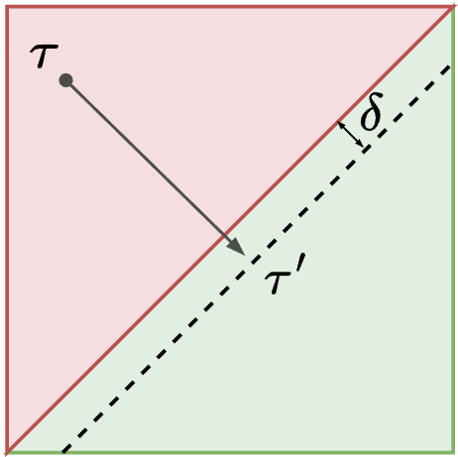
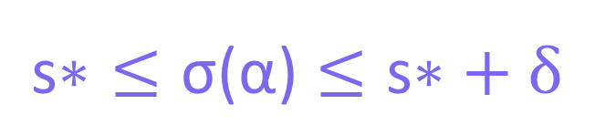

Counterfactual Problems for QBAFs
Strong
𝛿-Approximate
$$\text{σ}\text{(}\text{α}\text{)}=\text{s}\text{∗}$$
$$\text{s}\text{∗}≤\text{σ}\text{(}\text{α}\text{)}≤\text{s}\text{∗}+δ$$
CE-QArg: Counterfactual Explanations for Quantitative Bipolar Argumentation Frameworks. X. Yin, N. Potyka, F. Toni. KR, 2024.
Notes:
Next, we define three counterfactual problems. Depending on the position of \tau.
(They are strong /approximate /weak CF problems.)
(I will show a figure to distinguish these three problem.)
Strong: exactly hit the desired strength s*
Approx: relaxed version for the strong one, which requires crossing the boundary a little bit by \delta
Weak: more relaxed version:
(in case the base scores are discreet values in some settings, so difficult to meet the previous two constraints.)
In this work, we focus on delta-approximate problem.
(1) This is because ensuring the exact desired strength may be challenging, due to the complexity of gradual semantics that may involve various linear and non-linear transformation.
(2) And once we have found a solution to the delta-approximate problem, it is also a solution to the weak version according to the definition here.

Slide 33

Counterfactual Problems for QBAFs
Strong
𝛿-Approximate
Weak
$$\text{σ}\text{(}\text{α}\text{)}=\text{s}\text{∗}$$
$$\text{s}\text{∗}≤\text{σ}\text{(}\text{α}\text{)}≤\text{s}\text{∗}+δ$$
$$\text{σ}\text{(}\text{α}\text{)}≥\text{s}\text{∗}$$
CE-QArg: Counterfactual Explanations for Quantitative Bipolar Argumentation Frameworks. X. Yin, N. Potyka, F. Toni. KR, 2024.
Notes:
Next, we define three counterfactual problems. Depending on the position of \tau.
(They are strong /approximate /weak CF problems.)
(I will show a figure to distinguish these three problem.)
Strong: exactly hit the desired strength s*
Approx: relaxed version for the strong one, which requires crossing the boundary a little bit by \delta
Weak: more relaxed version:
(in case the base scores are discreet values in some settings, so difficult to meet the previous two constraints.)
In this work, we focus on delta-approximate problem.
(1) This is because ensuring the exact desired strength may be challenging, due to the complexity of gradual semantics that may involve various linear and non-linear transformation.
(2) And once we have found a solution to the delta-approximate problem, it is also a solution to the weak version according to the definition here.

Slide 34
Design an algorithm (CE-QArg) to identify CEs by updating the base scores.
Problem Solving
Two core modules
1. Polarity: updating direction
2. Priority: updating magnitude
CE-QArg: Counterfactual Explanations for Quantitative Bipolar Argumentation Frameworks. X. Yin, N. Potyka, F. Toni. KR, 2024.
Notes:
To solve this problem, we designed an algorithm (we call it CEQarg) to identify counterfactual explanations by changing the base scores.
To do so, we need to incorporate two core modules in the algorithm, which we call them polarity and priority.
Polarity determines the changing direction, we increase/decrease the base scores
Priority determines the changing magnitude, how much we increase/decrease.

Slide 35
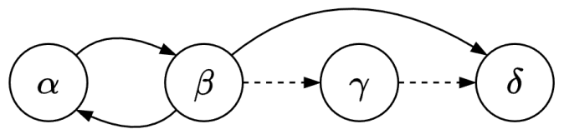
1. Polarity
Idea: To identify valid CEs (cross the decision boundary).
Intuition: Measure the impact from one argument to another.
Definition: (1) #path; (2) #attacks on each path (odd/even).
Example:
γ is neutral to β: no path
γ is positive to δ: 1 path, 0 attacks (even)
β is negative to α: infinite paths, 1,3,5… attacks (odd)
β is unknown to δ: 2 paths, 1 attack (odd); 0 attacks (even)
CE-QArg: Counterfactual Explanations for Quantitative Bipolar Argumentation Frameworks. X. Yin, N. Potyka, F. Toni. KR, 2024.
Notes:
【Adam：show that polarity is used to show the effect of arguments.】
【show that two attacks equals support】
The idea of introducing Polarity is to find valid CEs.
By valid we mean the final strength can cross (or go across) the decision boundary.
To do so, we need to distinguish 4 types of arguments.
Polarity distinguishes 4 types of arguments based on:
(1) the number of path between two arguments;
(2) The number of attacks on each path.
For example,
We say that gamma is neutral to….
One path has a positive influence and one path negative influence…
Now we have 4 types of arguments. For instance, if we want to increase the final strength, then we can increase the base scores of positive arguments or decrease those of negative ones.
However, we need some guarantees for the gradual semantics.

Slide 36
Property of Gradual Semantics (σ)
1. Directionality:
If β is neutral to α, then τ(β) does not affect σ(α).
2. Monotonicity:
If β is positive to α, then increase τ(β) will not decrease σ(α);
If β is negative to α, then increase τ(β) will not increase σ(α).
CE-QArg: Counterfactual Explanations for Quantitative Bipolar Argumentation Frameworks. X. Yin, N. Potyka, F. Toni. KR, 2024.
Notes:
The first one is directionality, which says …
The second one is monotonicity, which says…
Here we need to note that, only if \sigma satisfies these properties, then we can use polarity to change base scores.

Slide 37
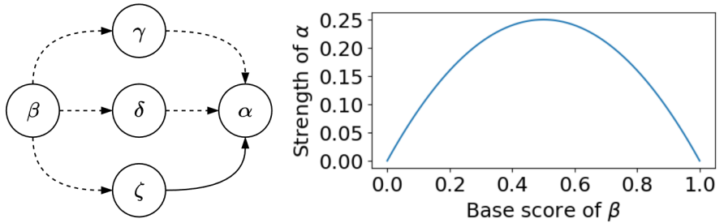
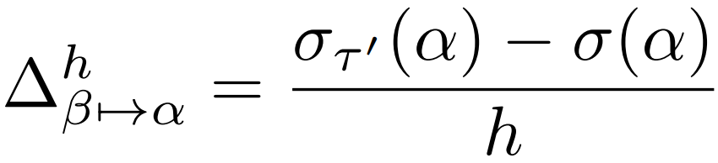
Unknown Arguments
Difference Quotient
CE-QArg: Counterfactual Explanations for Quantitative Bipolar Argumentation Frameworks. X. Yin, N. Potyka, F. Toni. KR, 2024.
Notes:
The last one is unknown argument, this is a bit tricky, because for example in this figure,
If when increasing the base score of beta, then we see the strength of \alpha first increases then decreases, which means there is no monotonic effect from beta to alpha.
To solve this problem, we use difference quotient to capture the local monotonic effect from beta to alpha,
that is, we increase base score of beta a little bit by h, then we see how sigma(alpha) changes.
If positive, then we increase beta, otherwise we decrease.

Slide 38
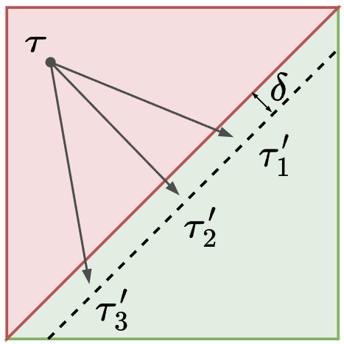

2. Priority
Idea: To identify cost-effective CEs in terms of the distance.
Intuition: Assigning higher updating magnitude to closer arguments.
Definition: The reciprocal of the shortest path length.
Example:
Priority from α to δ is 1/2: $<(α,β),(β,δ)>, 2$
Priority from β to δ is 1: $<(β,δ)>, 1$
CE-QArg: Counterfactual Explanations for Quantitative Bipolar Argumentation Frameworks. X. Yin, N. Potyka, F. Toni. KR, 2024.
Notes:
【idea and intuition a good name??????】
The reason why we define priority is because not only we want to change the output, but we also want to change it in a minimum cost, in terms of the distance between the CE and the original base score function.
Priority assigns higher updating magnitude to arguments closer to the topic argument in terms of path length,
Because we assume these arguments are more important than those farther away.
Polarity is defined as the reciprocal of the shortest path length.
(And we will empirically verify this hypothesis later.)
Here is an example, about the polarity from \alpha to \delta.
There are many path from alpha to beta, but of all the path, path1 is the shortest, which is from alpha to beta then beta to delta. So the priority is one half.
So means longer distance, lower priority.
So this means beta has a higher priority than alpha
“Assigning higher updating magnitude to arguments closer to the topic argument in terms of path length.”
=====================================
Which is composed of two key components
In each iteration, we have two key components
Polarity determines the updating direction
Priority determines how much we need to
the reciprocal of the shortest path length from one argument to another, which means we update more for those who are close to the topic argument than those further away.
We expect an appropriate priority can help identify cost-effective CEs in terms of Lp-norm distance.
And we will empirically verify this hypothesis later.

Slide 39



Updating function:
Two core modules:
1. Polarity: updating direction
2. Priority: updating magnitude
CE-QArg Algorithm
An iterative algorithm to identify valid and cost-effective CEs.
$$τ^{i+1}\left(β\right)←τ^{i}\left(β\right)+step ∙ polarity ∙ priority$$
$${10}^{−6}$$
$$0/1/−1$$
$$[0,1]$$
CE-QArg: Counterfactual Explanations for Quantitative Bipolar Argumentation Frameworks. X. Yin, N. Potyka, F. Toni. KR, 2024.
Notes:
After talking about two modules, then we use them to design the CE-Qarg.
Which is an iterative ……
Here, by valid we mean the CE is a solution to the problem, that is cross the decision boundary.
And by cost-effective we mean the distance is as short as possible.
We use the updating equation here, which in every iteration, we use a small step then multiples polarity to make sure a valid CE, and priority to make sure a cost-effective CE.
The i-th updating function is here:
Then, We update iteratively until the final strength cross the decision boundary.
解释为什么polarity可以保证validity
以及priority可以保证cost-effectiveness

Slide 40


CE-QArg Algorithm
An iterative algorithm to identify valid and cost-effective CEs.
Valid
$σ\left(α\right)<0.5$
Cost-effective
Iterative
$σ\left(α\right)≥0.5$
CE-QArg: Counterfactual Explanations for Quantitative Bipolar Argumentation Frameworks. X. Yin, N. Potyka, F. Toni. KR, 2024.
Notes:
解释3个红色的字体
After talking about two modules, then we use them to design the CE-Qarg.
Which is an iterative ……
Here, by valid we mean the CE is a solution to the problem, that is cross the decision boundary.
And by cost-effective we mean the distance is as short as possible.
We use the updating equation here, which in every iteration, we use a small step then multiples polarity to make sure a valid CE, and priority to make sure a cost-effective CE.
The i-th updating function is here:
Then, We update iteratively until the final strength cross the decision boundary.
解释为什么polarity可以保证validity
以及priority可以保证cost-effectiveness

Slide 41
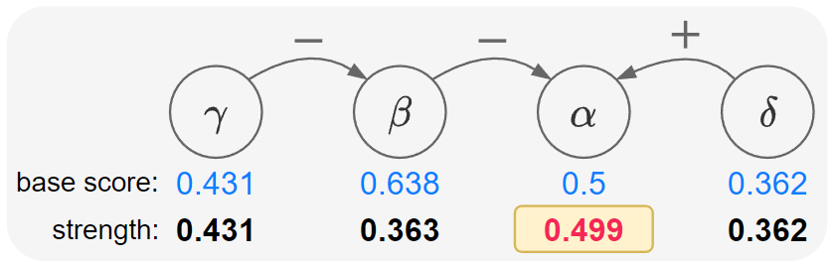
Counterfactual Explanations
CE-QArg: Counterfactual Explanations for Quantitative Bipolar Argumentation Frameworks. X. Yin, N. Potyka, F. Toni. KR, 2024.
Notes:
Now, I will show an example of applying Relation Attributions explanations to the previous QBAF.
Suppose that we want to explain the argument alpha.
To be clear, we labelled the edges with r1-r5.
Then we applied our method and got the results here:
We see that we have three blue edges, which means that they have positive influence, and we have two red edges which means that have negative influence on the alpha.
Among positive contributions, r1 and r2 are the main contributors, this is because gamma directly supports alpha through r1 and delta directly supports alpha through r2.
As for r3, since gamma supports delta, and delta supports alpha, so gamma indirectly supports alpha through r3 and r2, so r3 has a positive influence on alpha,
but r3 is not directly connected to alpha, so the magnitude is less than that of r1 and r2.
Among negative contributors, r5 is the main contributor as beta directly attacks alpha through r5;
R4 is a minor negative contributor because beta attacks delta, and delta is a supporter of alpha, so beta indirectly attacks alpha through r4 and r2.
Here, what is worth mentioning is that if we sum up all the relation attributions, then the sum exactly equals to the difference between the base score and final strength of alpha,
which explains how the base score changes to the final strength under the evaluation of gradual semantics.

Slide 42
Counterfactual Explanations
CE-QArg: Counterfactual Explanations for Quantitative Bipolar Argumentation Frameworks. X. Yin, N. Potyka, F. Toni. KR, 2024.
Notes:
Now, I will show an example of applying Relation Attributions explanations to the previous QBAF.
Suppose that we want to explain the argument alpha.
To be clear, we labelled the edges with r1-r5.
Then we applied our method and got the results here:
We see that we have three blue edges, which means that they have positive influence, and we have two red edges which means that have negative influence on the alpha.
Among positive contributions, r1 and r2 are the main contributors, this is because gamma directly supports alpha through r1 and delta directly supports alpha through r2.
As for r3, since gamma supports delta, and delta supports alpha, so gamma indirectly supports alpha through r3 and r2, so r3 has a positive influence on alpha,
but r3 is not directly connected to alpha, so the magnitude is less than that of r1 and r2.
Among negative contributors, r5 is the main contributor as beta directly attacks alpha through r5;
R4 is a minor negative contributor because beta attacks delta, and delta is a supporter of alpha, so beta indirectly attacks alpha through r4 and r2.
Here, what is worth mentioning is that if we sum up all the relation attributions, then the sum exactly equals to the difference between the base score and final strength of alpha,
which explains how the base score changes to the final strength under the evaluation of gradual semantics.

Slide 43
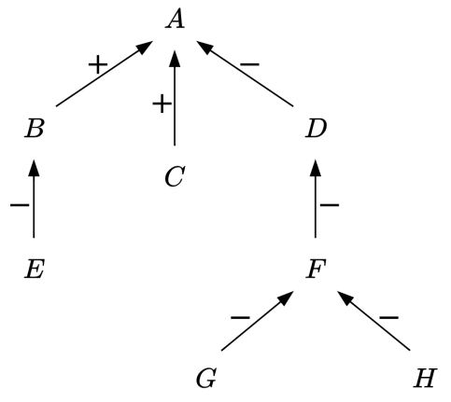
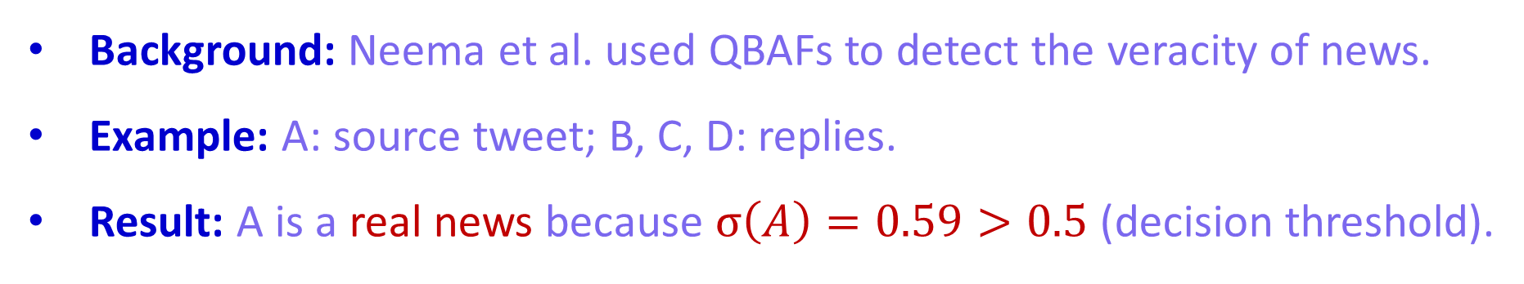
A Case Study: Fake News Detection
Background: Neema et al. used QBAFs to detect the veracity of news.
Example: A: source tweet; B, C, D: replies.
Result: A is a real news because $σ\left(A\right)=0.59>0.5$ (decision threshold).
Notes:
Here, I am going to show a case study in fake news detection.
Neema et al …
For example, A is the source tweet and BCD are the replies to A, then EFGH are the replies to the replies.
The result is that …

Slide 44
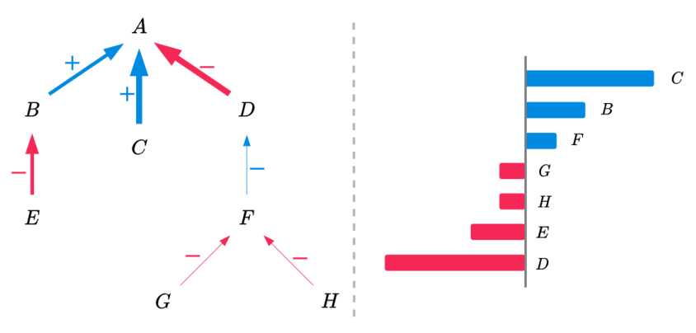
A Case Study: Fake News Detection
Qualitatively: 1. B, C and F have positive influences on A;
2. D, E, G, H have negative influences on A.
Quantitatively: 1. how much they contribute to A;
2. who has the largest (pos/neg) contribution to A.
Compared to dialogical explanations, AAEs provide a quantitative insight.
Notes:
Next, I am going to use our AAEs to explain why this is a real news.
We show the ranking of the attribution scores on the right side.
We can draw explanations from two aspects.
Qualitatively,

Slide 45
Conclusion
QBAF
AAEs
RAEs
CEs
Notes:
Now, I will show an example of applying Relation Attributions explanations to the previous QBAF.
Suppose that we want to explain the argument alpha.
To be clear, we labelled the edges with r1-r5.
Then we applied our method and got the results here:
We see that we have three blue edges, which means that they have positive influence, and we have two red edges which means that have negative influence on the alpha.
Among positive contributions, r1 and r2 are the main contributors, this is because gamma directly supports alpha through r1 and delta directly supports alpha through r2.
As for r3, since gamma supports delta, and delta supports alpha, so gamma indirectly supports alpha through r3 and r2, so r3 has a positive influence on alpha,
but r3 is not directly connected to alpha, so the magnitude is less than that of r1 and r2.
Among negative contributors, r5 is the main contributor as beta directly attacks alpha through r5;
R4 is a minor negative contributor because beta attacks delta, and delta is a supporter of alpha, so beta indirectly attacks alpha through r4 and r2.
Here, what is worth mentioning is that if we sum up all the relation attributions, then the sum exactly equals to the difference between the base score and final strength of alpha,
which explains how the base score changes to the final strength under the evaluation of gradual semantics.

Slide 46
Future Work
Contestable AI
Evaluative AI
Notes:
In conclusion of this work:
(1)(2)(3)
For future work,
it would be interesting to explore different forms of CEs and carry out case studies to verify the theory;

Slide 47



Thank you
Dr Xiang Yin
Imperial College
Personal Website
Google Scholar
Notes:
【最后记得统一调整页码】
Okay, That’s it!
I hope you enjoyed this work.
We have the QR code for our paper and our group if you are interested.
Thank you for your listening!

